Slide 1



毕业论文答辩
GRADUATION THESIS DEFENSE
HEART DISEASE PREDICTION SYSTEM USING MACHINE LEARNING
Name：ABDULKADIR DURAN ADAN
Student ID: 5035190144
Supervisor：Professor Lu Hengyang
Department: Artificial Intelligence and Computer Science major: Computer Science and Technology

Slide 2
Contents
01
Introduction
02
Literature review
Methodology
04
Data analysis
03
05
Heart disease prediction Web App

Slide 3

01
Introduction

Slide 4
Background Overview
Globally heart disease is of One of the leading causes of death around the world.
By 2030, the WHO predicts that there will be 23.6 million heart disease-related deaths in the worldwide.
Predicting and diagnosing heart disease is the biggest challenge in the medical industry.
Machine learning has grown as an important tool for predicting and diagnosing heart disease as a result of technological advancements.
Machine learning methods can be used in order to save lives and lessen the financial burden on society.

Slide 5
Research objective
1
Help doctors and users to detect heart disease so that it can be prevented & cured at early stage, thereby saving many lives.
Main objectives of The research
Use machine learning algorithms, to create predictive web app system that can correctly detect whether someone has heart disease or not.
2
3
Help patients who are at high risk of heart disease and cannot afford or use certain technologies, such as CT scans and electrocardiograms, which are essential for diagnosing heart disease.

Slide 6

02
Literature review

Slide 7
Author
Title
Findings
Result accuracy
Gap
According to the study’s findings, The suggested approach may be a helpful tool for doctors in predicting CVD risk, helping to develop better treatment plans, and facilitating early diagnosis.
The machine learning model was used to predict CVD only which is a type heart disease and one machine learning algorithm was used.
cardiovascular disease (CVD) prediction Using Machine learning
Narin Ali, 2016
98.57%
This machine learning methods were mainly used for predicting CVD and it may not be the right models and methods for the predicting the other types of heart disease
Heart Disease Prediction using Machine Learning Techniques
Devansh Shah, 2020
The study's findings showed that the KKN model had the highest level of accuracy
90.8%

Slide 8
Author
Title
Findings
Result accuracy
Gap
The machine learning model was trained to identify the most important risk factors for cardiovascular disease (CVD) in patients with metabolic-associated fatty liver disease only.
Risk factors for cardiovascular disease in patients with metabolic-associated fatty liver disease using machine learning techniques
Karolina Drożdż,
2022
Based on straightforward patient criteria, the study's findings suggest that an ML method is useful for identifying MAFLD patients with widespread CVD. .
85.57%

Slide 9

03
Methodology

Slide 10
Research methods
Data Source
This dataset was provided by Cleveland Clinic Foundation.
This dataset consists of 13 features and a target variable.
Target variable is the variable which we have to predict 1 means patient is suffering from heart risk and 0 means patient is normal
Jupyter notebook
Data Description
IDE
Research methods
Machine Learning algorithms used
Logistic regression
K-Nearest Neighbors
Naive Bayes
Decision Tree,
Random Forest
Pandas
NumPy
Matplotlib
Seaborn
Scikit -learn
Training model and Data analysis tools

Slide 11

04
Data analysis

Slide 12
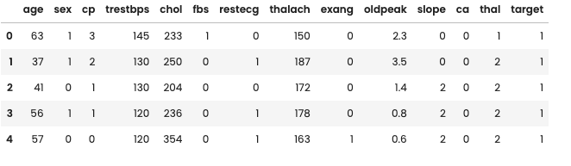
Features of the dataset
Figure 1: displaying sample entries of dataset

Slide 13
Exploratory Data Analysis
EDA helps us to understand and explore different pieces of information, including averages, mean, minima and maxima, and other relevant points.
More importantly, EDA can help analysts identify major errors, any anomalies, or missing values in their dataset.

Slide 14
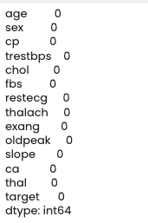
Checking Missing values
Figure 2: Checking missing entries in the dataset columnwise

Slide 15
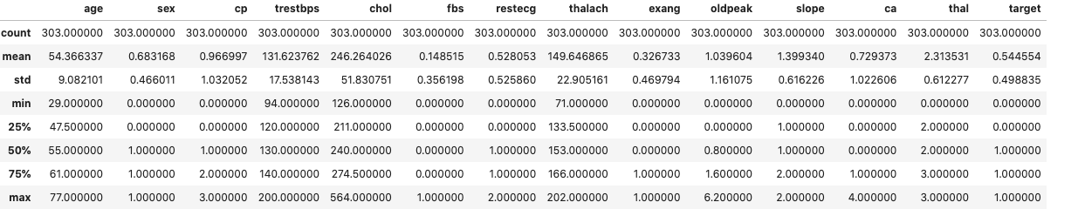
Numerical statistics of columns including averages, mean, minima and maximum
Figure 3: Numerical statistics of columns

Slide 16
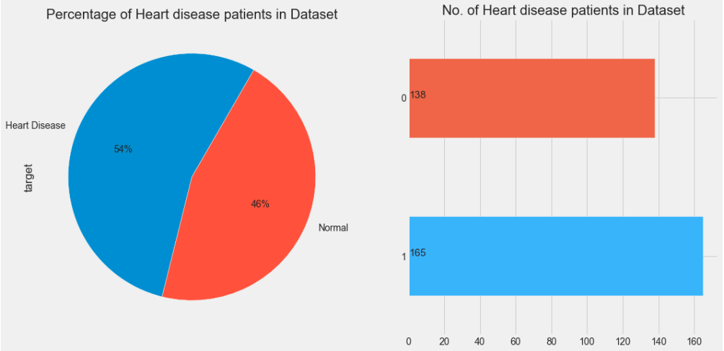
Distribution of Heart disease (target variable)
Figure 4: Distribution of Heart disease

Slide 17
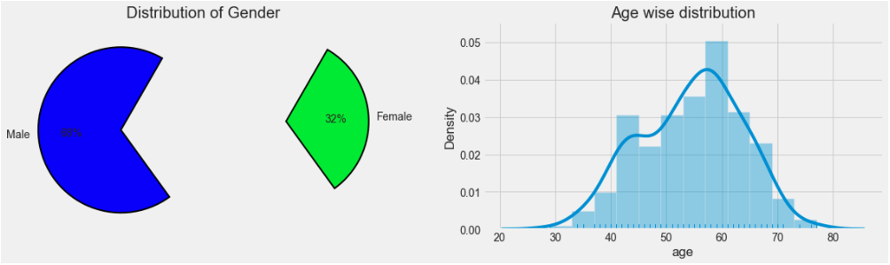
Distribution of Heart disease (Gender
Figure 5: Checking Gender & Agewise Distribution

Slide 18
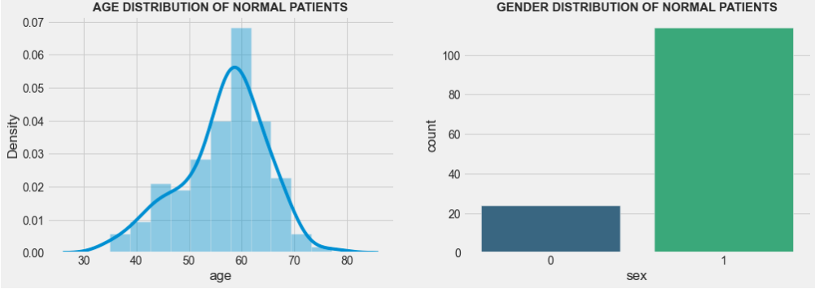
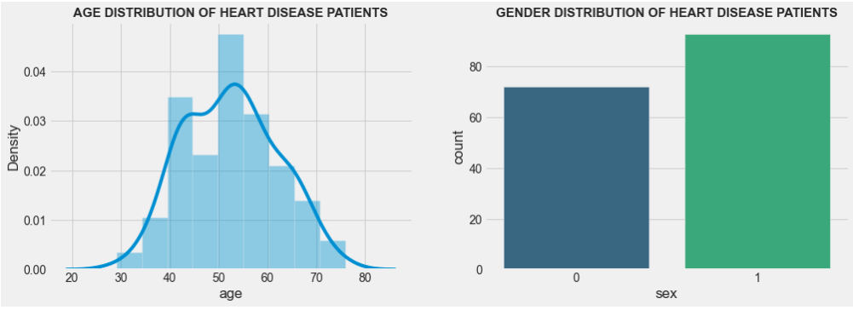
AGE DISTRIBUTION OF NORMAL AND HEART DISEASE PATIENTS
Figure 6: Age distribution

Slide 19
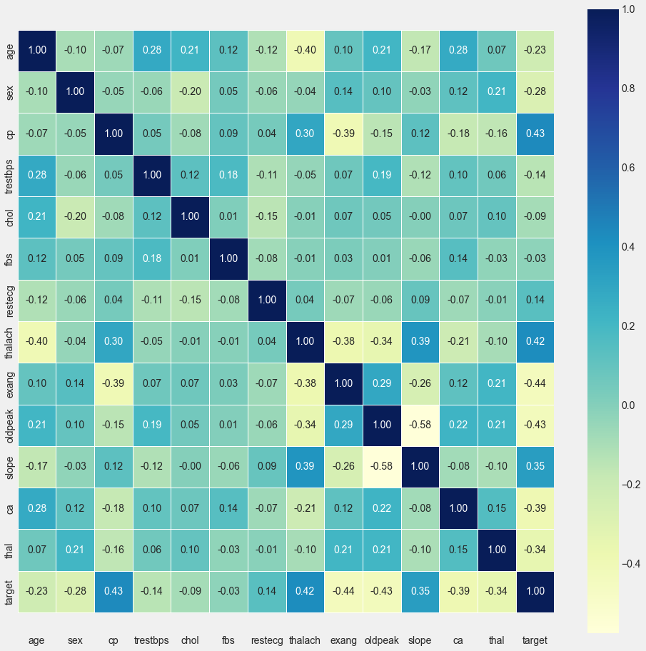
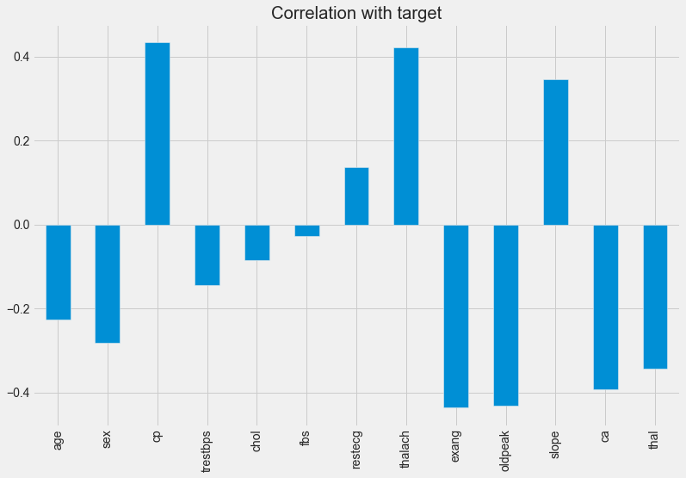
Correlation Matrix
Figure 8: Correlation matrix

Slide 20
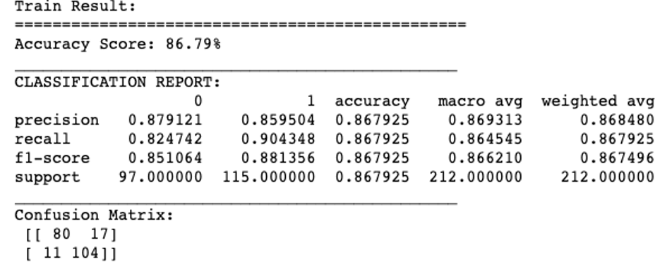
Train Model and Test Split

Slide 21
Comparing results of different algorithms and display accuracy score
ML Algorithm used | Accuracy score %
Logistic Regression | 86.81
K-Nearest Neighbors | 85.71
Naive Bayes | 68.13
Decision Tree | 82.42
Random Forest | 86.81

Slide 22

05
Heart disease prediction Web App

Slide 23
Introduction to the system
It is Machine Learning web app with a user-friendly interface that is deployed with flask o serve as a web server framework that accepts HTTP request coming from the fronted.
It predicts whether the patient is suffering from heart disease or not.
Tools and Technology Used to build this system.
HTML to define structure of web pages content.
CSS to style and design the web pages.
Bootstrap (Modern responsive CSS framework)
JavaScript to convert static web pages into an interactive.
NumPy to manipulate a large collection of high-level mathematical functions.
Panadas for data manipulation and analysis.
Scikit-learn to train the model and give accurate result using different logistic regression.
Flask to serve as a web server framework to serve HTTP request coming from the fronted.

Slide 24
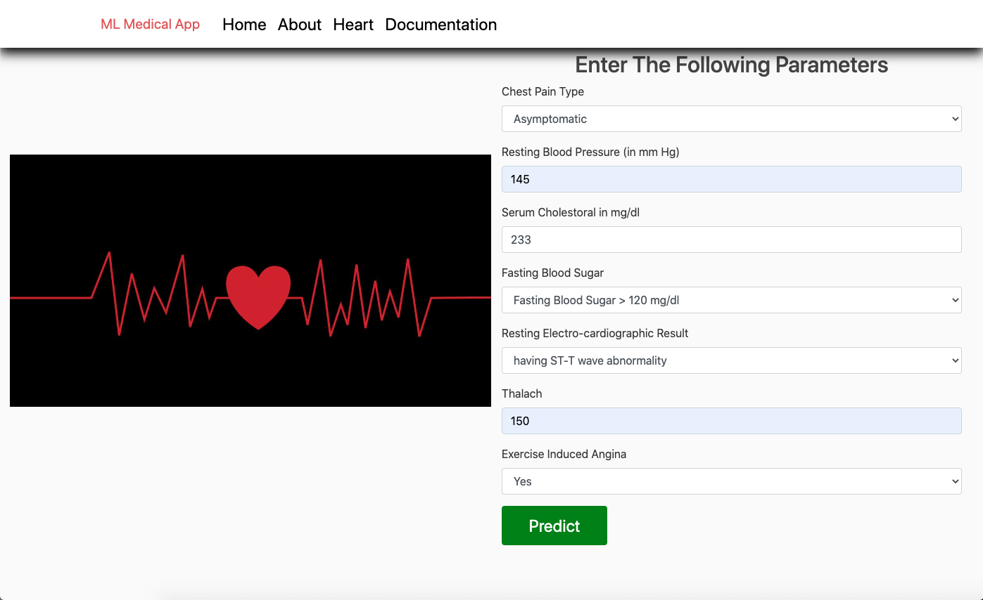
System Checking
User Input

Slide 25
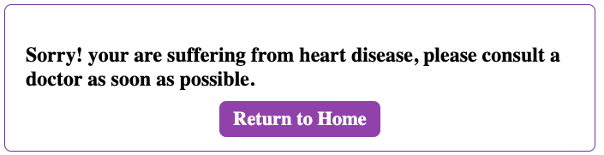
System response

Slide 26
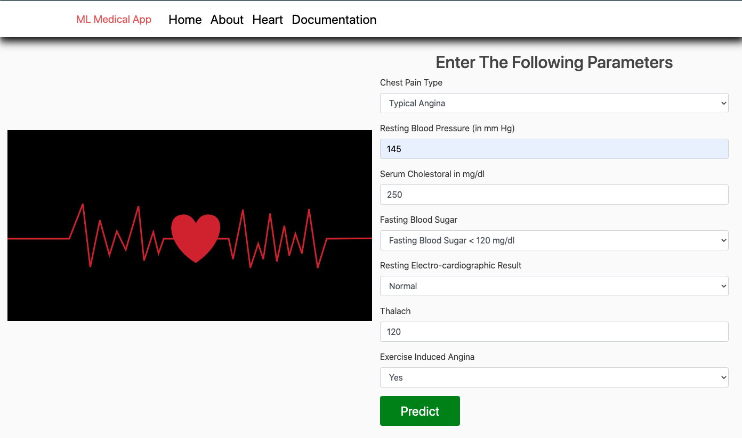
User Input

Slide 27

System response

Slide 28
THANKS
感谢恩师

